Slide 1


Optimizing MapReduce Performance for Large-Scale Data Processing
By
Saravanan k
192210710

Slide 2

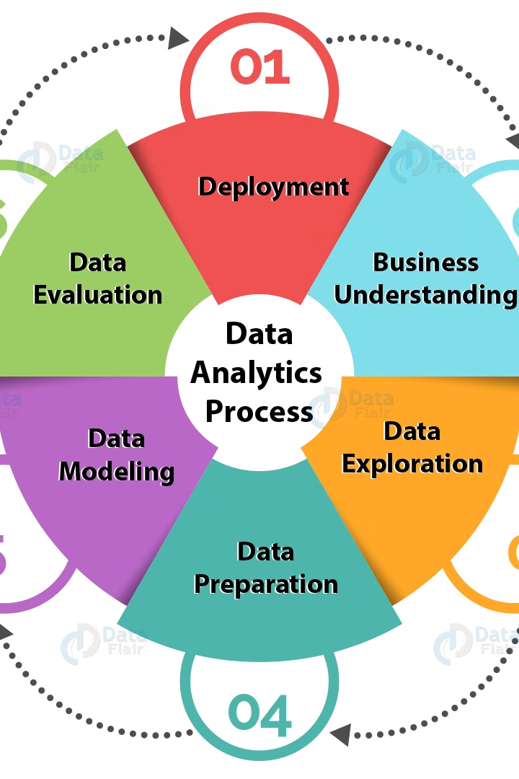
The Power of MapReduce for Big Data
MapReduce is a powerful framework that enables efficient and scalable computation on distributed systems, making it widely used across various industries for tasks such as data analysis, machine learning, and search engine indexing.
The framework simplifies distributed processing by dividing large datasets into smaller chunks, allowing for parallel processing across multiple nodes.

Slide 3

Understanding MapReduce: A Deep Dive
MapReduce is a powerful framework for processing large datasets across multiple machines. It is widely used in cloud computing environments such as Amazon Web Services (AWS) and Google Cloud Platform (GCP) for tasks such as data analysis, machine learning, and scientific computing.

Slide 4
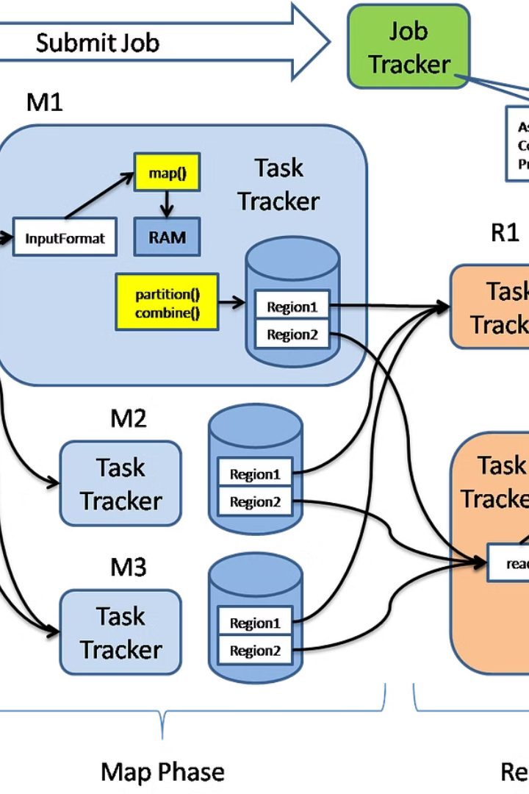
Performance Bottlenecks in MapReduce
MapReduce, while powerful, can be slowed by various factors. These bottlenecks affect the speed and efficiency of data processing, limiting the overall performance of large-scale applications.

Slide 5
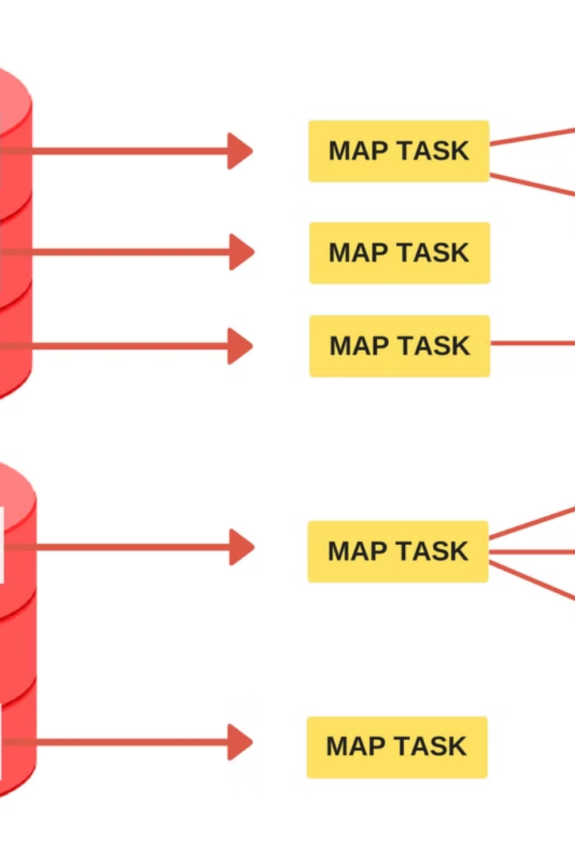
Optimization Strategies: Data Partitioning and Sorting
Data partitioning is crucial for parallel processing in MapReduce. Efficient partitioning ensures balanced workloads across worker nodes, reducing execution time.
Sorting data within each partition before the shuffle phase improves efficiency. Sorted data allows for efficient aggregation and joining operations, enabling faster processing and reduced memory consumption.

Slide 6

Optimization Strategies: Data Locality and Replication
Data locality and replication are crucial for efficient MapReduce performance. By placing data closer to the processing nodes, network traffic and latency are minimized, leading to faster execution times. Replication of data across multiple nodes ensures high availability and fault tolerance, allowing the system to continue operating even if some nodes fail.

Slide 7

Optimization Strategies: Task Scheduling and Resource Allocation
MapReduce task scheduling and resource allocation directly influence job performance. The framework aims to distribute tasks efficiently among available nodes, minimizing idle resources and maximizing resource utilization. By intelligently assigning tasks to specific nodes, MapReduce can enhance data locality, reduce communication overhead, and accelerate overall processing.

Slide 8
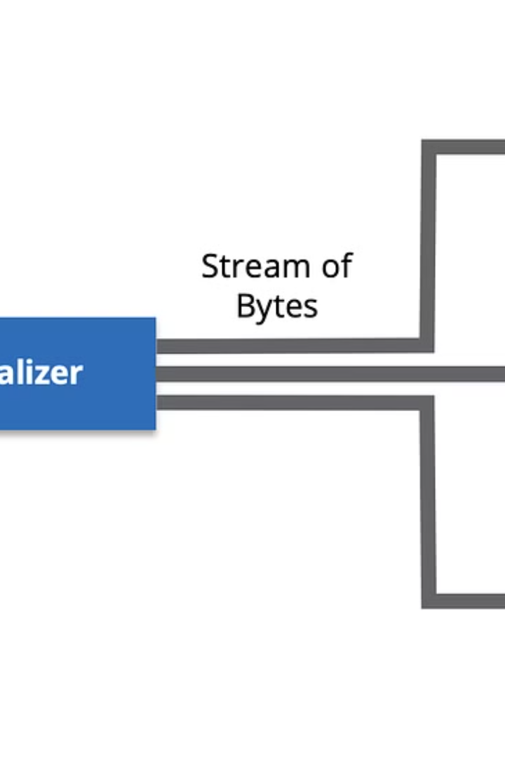
Optimization Strategies: Data Compression and Serialization
Data compression and serialization are powerful techniques for optimizing MapReduce performance.
Compression reduces the size of data transferred between nodes, decreasing network bandwidth usage and processing time.
Serialization converts data into a format suitable for transmission and storage, enabling efficient data exchange and storage.

Slide 9

Optimization Strategies: Input/Output Optimization
Efficient data transfer between the MapReduce framework and the underlying storage system is crucial for achieving optimal performance. Optimizing input/output (I/O) operations can significantly reduce job execution time and improve overall efficiency.

Slide 10

Case Study: Optimizing a Real-World MapReduce Job
This section will showcase a practical example of how MapReduce optimization techniques are applied to a real-world scenario.
We will analyze a specific MapReduce job, identifying its performance bottlenecks and demonstrating the effectiveness of the optimization strategies discussed earlier.

Slide 11

The Future of MapReduce and Big Data Processing
While MapReduce has been a cornerstone of big data processing, new

Slide 12


